Slide 1
Complexity of conventional Sorting Algorithms
Course Code: CSC2211
Course Title: Algorithms
Dept. of Computer Science
Faculty of Science and Technology
Lecturer No: |  | Week No: |  | Semester:
Lecturer: | Nyme Ahmed [nyme.ahmed@aiub.edu]

Slide 2
Lecture Outline
1. Sorting Algorithms
Counting Sort

Slide 3
Sorting Algorithms with linear time

Slide 4
Counting Sort
Counting sort: No comparisons between elements.
Input: A[1 . . n], where A[j] ∈ {1, 2, . . . , k}.
Output: B[1 . . n], sorted.
Auxiliary storage: C [1 . . k].
1 for i ← 1 to k
2
3 for j ← 1 to n
4
5 for i ← 2 to k
6
7 for j ← n downto 1 8
9
do C [i ] ← 0
do C [A[j]] ← C [A[j]] + 1
d C [i ] = |{key = i }|
d C [i ] = |{key ≤ i }|
do C [i ] ← C [i ] + C [i − 1]
do B[C [A[j]]] ← A[j]
C [A[j]] ← C [A[j]] − 1
12 / 26

Slide 5
Counting sort simulation
A =
Here,
n = 5
min = 1; max = 4
So, range = 1 to 4 = 4 (1, 2, 3, 4)
Step 1:
A =
1 2 3 4
C1 =
4 | 1 | 3 | 4 | 3
4 | 1 | 3 | 4 | 3
0 | 0 | 0 | 0

Slide 6



Counting sort simulation
Step 2:
A =
1 2 3 4
C1 =
Step 3:
A =
1 2 3 4
C1 =
C2 =
1 | 0 | 2 | 2
1 | 1 | 3 | 5

Slide 7
Counting sort simulation
Step 4:
A =
1 2 3 4
C1 =
C2 =
B =
index 0 1 2 3 4
4 | 1 | 3 | 4 | 3
1 | 1 | 3 – 1 = 2 | 5
 |  | 3

Slide 8
Counting sort simulation
Step 5:
A =
1 2 3 4
C1 =
C2 =
B =
index 0 1 2 3 4
4 | 1 | 3 | 4 | 3
1 | 1 | 2 | 5 – 1 = 4
 |  | 3 |  | 4

Slide 9
Counting sort simulation
Step 6:
A =
1 2 3 4
C1 =
C2 =
B =
index 0 1 2 3 4
4 | 1 | 3 | 4 | 3
1 | 1 | 2 – 1 = 1 | 4
 | 3 | 3 |  | 4

Slide 10
Counting sort simulation
Step 7:
A =
1 2 3 4
C1 =
C2 =
B =
index 0 1 2 3 4
4 | 1 | 3 | 4 | 3
1 – 1 = 0 | 1 | 1 | 4
1 | 3 | 3 |  | 4

Slide 11
Counting sort simulation
Step 8:
A =
1 2 3 4
C1 =
C2 =
B =
index 0 1 2 3 4
4 | 1 | 3 | 4 | 3
0 | 1 | 1 | 4 – 1 = 3
1 | 3 | 3 | 4 | 4

Slide 12
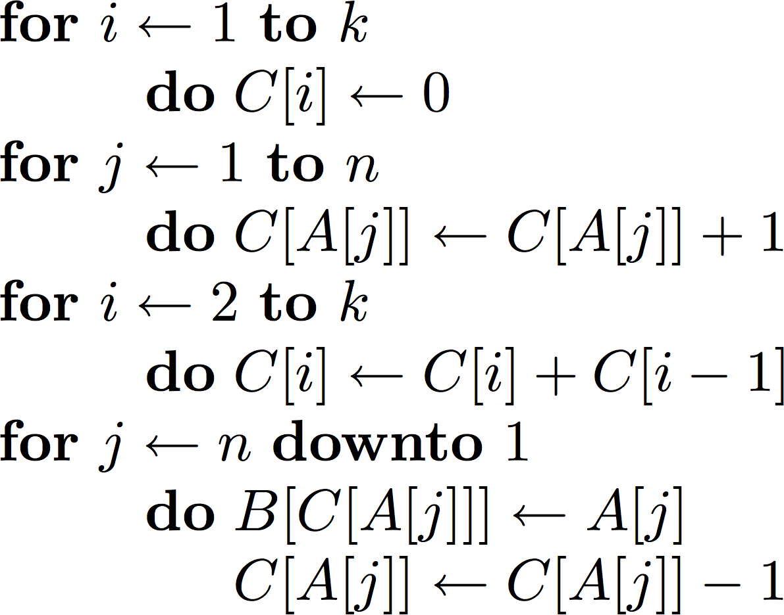
Counting sort Complexity
O(k)
O(n)
O(k)
O(n)
O(n + k)
The worst-case running time of Counting sort is O(n + k).
If k = O(n), then the worst case running time is O(n).

Slide 13
Books
Introduction to Algorithms, Thomas H. Cormen, Charle E. Leiserson,
Ronald L. Rivest, Clifford Stein (CLRS).
Fundamental of Computer Algorithms, Ellis Horowitz, Sartaj Sahni, Sanguthevar Rajasekaran (HSR)

Slide 14
References
https://www.google.com/search?q=bubble+sort+
step+by+step&sxsrf=ALeKk01uxzgfT3Oy6k1Q3WxVnSpiIN8_4g:1587999728942
&tbm=isch&source=iu&ictx=1&fir=vRwFsGwVfJ6pJM%253A%252CSzhhze6MPQr4c
M%252C_&vet=1&usg=AI4_-kSrEEXqwRL-PkHhVUtn7jNfF9dB6g&sa=X&ved=2ahUK
Ewje0Pz974jpAhXRAnIKHWhMD2UQ_h0wAXoECAcQBg#imgrc=EN4Sdu7veOWVo
M&imgdii=eOqvCu85p9-eBM
https://www.interviewcake.com/concept/java/counting-sort
https://www.geeksforgeeks.org/counting-sort/
https://www.hackerearth.com/practice/algorithms/sorting/quick-sort/tutorial/
https://www.cs.usfca.edu/~galles/visualization/CountingSort.html

